Slide 1
The Role Of Neoadjuvant Treatment In Esophageal Cancer
Presented by:
Dr. Karam Jeji

Slide 2
Introduction
Is the neoadjuvant therapy in addition to surgery will offer more significant results ?

Slide 3
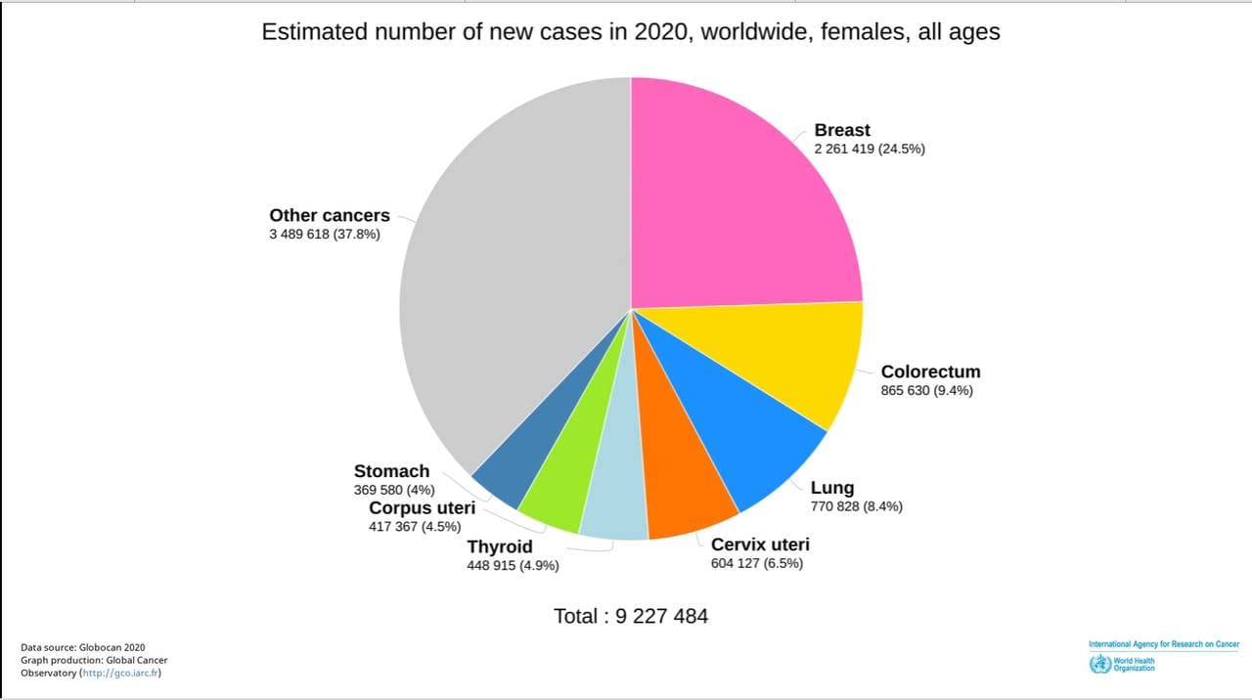
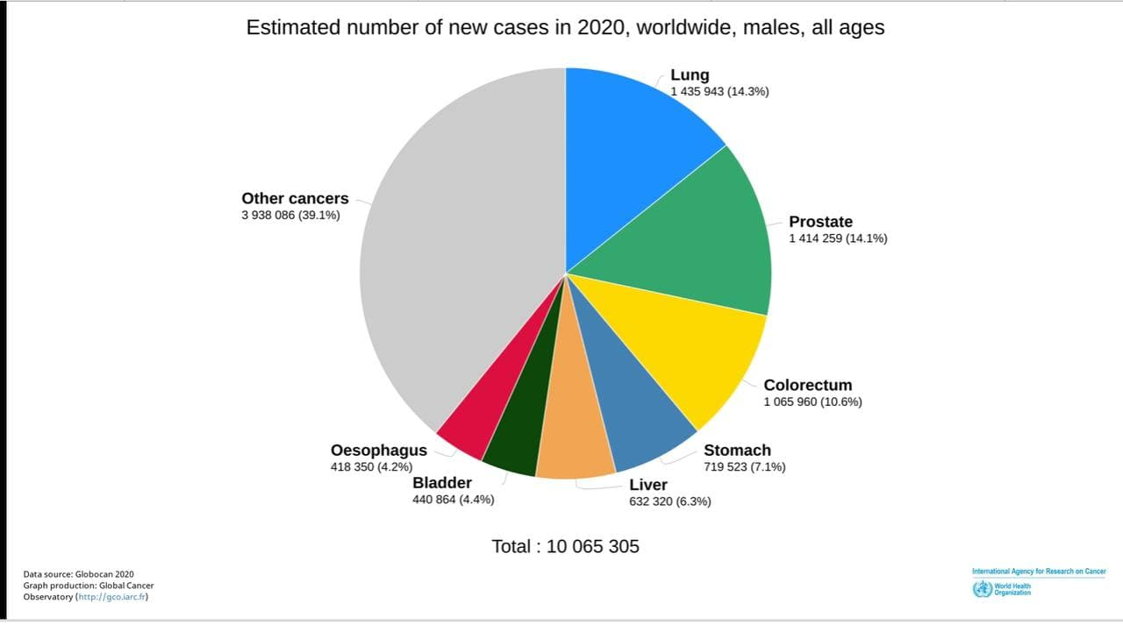

Slide 4
Epidemiology and Pathology
The 7th most diagnosed caner world wide
The 6th leading cause of cancer related deaths
Male > Female
Most common histologic types : ADC & SCC
Others : small cell carcinoma – SCC with sarcomatoid features – leiomyosarcoma – melanoma – Kaposi …

Slide 5
Treatment
Advanced stages ≥ T2 and/or N+ M0
Surgery alone ( failure of treatment )
So what next ???

Slide 6
Preoperative Chemotherapy
INT0113 trial studied the addition of chemotherapy before surgery and compared it to surgery alone.
Enrollment 443 patients.
Failed to get any significant results.

Slide 7
Preoperative Chemotherapy

Slide 8
Cont.
OEO2 trial:
802 patients.
2 cycles CIS + 5fu followed by surgery vs. surgery alone.
 | Cis + 5fu followed surgery | Surgery alone
Median overall survival | 16,8 months | 13,3 months
2 years | 43% | 34%
5 years | 23% | 17%

Slide 10
Preoperative Chemoradiotherapy
CROSS trial :
366 patients T2-T3, N0-1, M0.
178 received neoadjuvant CRT (75% ADC & 25% SCC)
188 underwent surgery alone.
Weekly (Craboplatin 2 AUC + Paclitaxel 50mg/m2) + RT 41,4 gry f/b surgery Vs. Surgery alone.

Slide 13
CONT.
PHASE 2 SWOG trial :
93 patients.
Stage 2 or 3.
Received folfox + RT.
28% PCR.
3years OS 45%.

Slide 14
Cont.
PROTECT trial : (ONGOING TRIAL)
National Cancer Institute , France
Comparison CROSS Vs. SWOG.
106 patients.
Started at FEB./2015.
Expected ending at JUNE/2023.

Slide 15
Perioperative Chemotherapy
MAGIC trial:
503 Patients.
3 cycles of ECF f/b surgeries & 3 cycles after Vs. surgery alone.

Slide 18
Cont.
NEORES trial compared NCRT Vs. NCT.
181 Patients majority of them T3N1( ADC&SCC).
3 cycles of cis + 5fu f/b surgery Vs. the same regimen +RT 40 grays.

Slide 19
Preoperative Chemoradiotherapy Vs. Perioperative Chemotherapy
NEOAEGIS trial:
Compare MAGIC/FLOT4 vs. CROSS.
362 patients (187 CROSS Vs. 184 MAGIC/FLOT)
FLOT 27 patients.
Majority of patients T3N1.

Slide 20
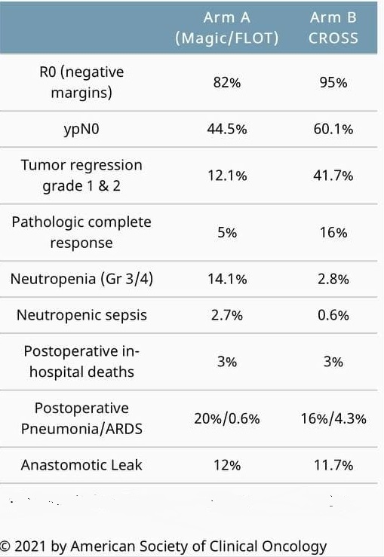

Slide 22
Cont.
ESOPEC trial : (ongoing trial)
438 patients
Achen, Germany
FLOT4 VS CROSS
Started at Jan./2016
Expected ending June/2024

Slide 23
Conclusion
What is the preferred modality of neoadjuvant treatment for advanced Esophageal ADC?
Preoperative CRT / perioperative CT Should be offered to patients with locally advanced ADC.
Perioperative CT should be reserved for lower esophageal ADC & EGJ.
Preoperative CRT should be reserved for patients with bulky disease , more proximal extension and for whom surgery will get less optimal results (R0 enough nodes number dissection).
Keep in mind the complications and mortality rate post treatment which is higher in CRT.

Slide 24
Cont.
What is the preferred modality of neoadjuvant therapy for patients with advanced SCC ?
Preoperative CRT or definitive CRT (cervical <5 cm from the cricopharengeus muscle).
Preoperative CRT has more positive effect on SCC.
If the RT is not an option then NCT should be considered like (invasion of trachea, large vessels, heart or body of vertebrae).

Slide 25
References
Devita _Hellman_and_Rosenberg_Cancer
NCCN GUIDELINES
JOURNAL OF CLINICAL ONCOLOGY
ASCO ANNUAL MEETING
JOURNAL OF THORASIC DISEASE, JTD

Slide 26
Thank you

